Slide 1
Data management and masking on Azure
Sujatha Kestur

Slide 2

Data Breach/Threats

Slide 3
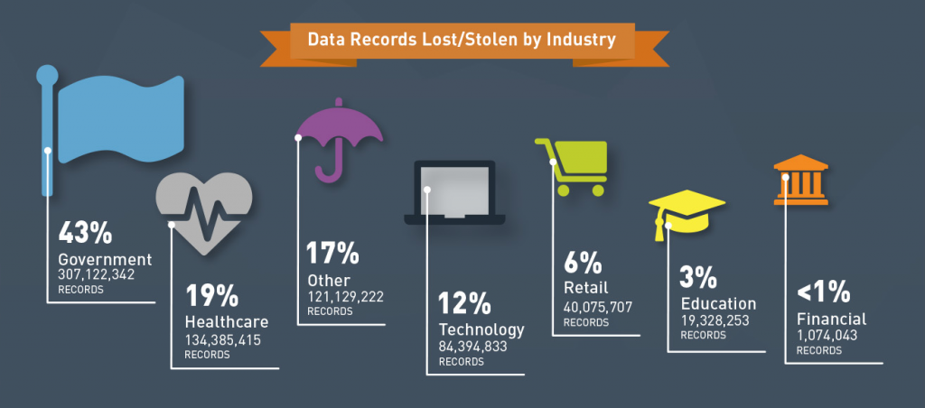
Data Records Lost/Stolen by Industry

Slide 4
Data Breach and Threats
A data breach is an incident where information is stolen or taken from a system without the knowledge or authorization of the system’s owner
A breach of protected health information (“PHI”) is defined as the acquisition, access, use, or disclosure of unsecured PHI, in a manner not permitted by HIPAA, which poses a significant risk of financial, reputational, or other harm to the affected individual
How to “protect” the personal/health records or financial records without compromising the usability of the data?

Slide 5
Problem Statement
In a world that is getting more and more data driven, the need of the current hour is to protect the data from unauthorized access without compromising the usability
The 2 common ways of achieving this is either by ENCRYPTING your data or MASKING it
Encryption is the process of transforming information by using some algorithm to make it unreadable to anyone except those possessing a key.
Data masking hides data elements that users of certain roles should not see and replaces them with similar-looking fake data. This enables the data to be still usable whilst also protecting the personal information
Fundamental Difference: For encryption, reversibility is required, and for masking, reversibility is a weakness.

Slide 6
Data Masking
The main intention of this project is to showcase that this unauthorized access can be cut off by masking the data.
It is also to showcase how to mask the data when it is on cloud using out of box service available from Azure
The project also intends to show how the data is still usable for down stream processes even with only “masked view” of the data
The kind of data masking that we are talking about/showcasing from this project perspective is Dynamic data masking
Dynamic data masking is a service available out of box in Azure
The project measures the number of different breast cancer diagnosis by year of diagnosis and number of breast cancer patients by state of residence

Slide 7
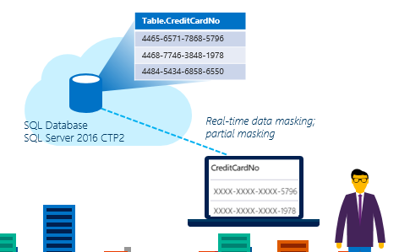
Dynamic Data Masking

Slide 8
Dynamic data masking
Dynamic data masking helps prevent unauthorized access to sensitive data by enabling customers to designate how much of the sensitive data to reveal with minimal impact on the application layer.
This is a policy-based security feature that hides the sensitive data in the result set of a query over designated database fields, while the data in the database is not changed.
The benefits DDM specifically offers include
Simple to create
No need of modifying the database procedures or application code
Little to no performance impact on database operations

Slide 9
Data set
Disclaimer: For the purpose of this project, I have considered a smaller dataset to migrate from on prime to Azure
There are 3 different tables which are used
Patient – The data for patient was obtained from the patient matching challenge data set that was provided by federal government. This is publicly available. Patient table has a referential integrity with the provider table
https://www.challenge.gov/challenge/patient-matching-algorithm-challenge/
Provider – This table is about basic provider/doctor information. This data was made up
Patient_Metastatis – This again is made up data which contains the patient diagnosis for breast cancer. This has a referential integrity with the patient table

Slide 10
Data Set(contd..)
The public dataset was close to 2 million records. This was cleansed to remove NULL last and first names, NULL date of birth, NULL SSN, NULL MRN and NULL phone numbers
The final data that was loaded into the sql server table was 42719
A RACE/ETHNICITY column was added into the patient table to enable to run statistics on the number of breast cancer detections by race

Slide 11
Technology and Software
Visual studio 2017
Is used to develop a console application for data movement between the storage blob and the sql server tables
Can be downloaded from https://www.visualstudio.com/downloads/
SQL Server management studio 2017
Is used in the project to connect to the sql server hosted on cloud.
Can be downloaded from https://docs.microsoft.com/en-us/sql/ssms/download-sql-server-management-studio-ssms
Oracle 12
Is used to cleanse the data obtained from the federal government website and to mock up the data for other tables
Tableau 10.5
Used for data visualization
Can be downloaded from www.tableau.com

Slide 12
Process Overview
Create a resource group on cloud to hold all the relevant components for your project/application
Create a SQL server and a sql database
Create tables and users in the sql database
Create a Azure storage account and container to hold your flat files
Create a .Net console application which creates a azure data factory to move the data from the flat files in the container to the tables on the database
Mask the data for required users on the sql server
Show the data visualization

Slide 13
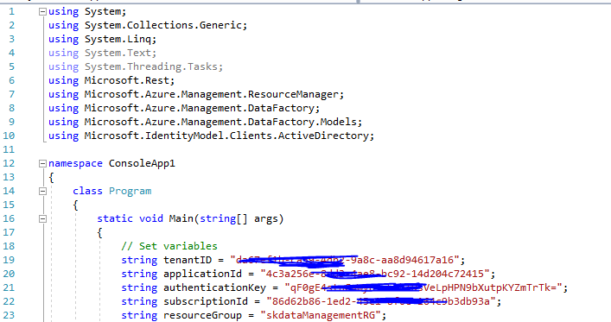
Code Overview
Overview of steps
Install visual studio 2017, SQL server management studio 2017
Data cleansing and creating flat files – clean the data set and or mock up the data that needs to go into the database. Create delimited text files out of them
Create a console .Net application
The code in the program.cs would look like below

Slide 14
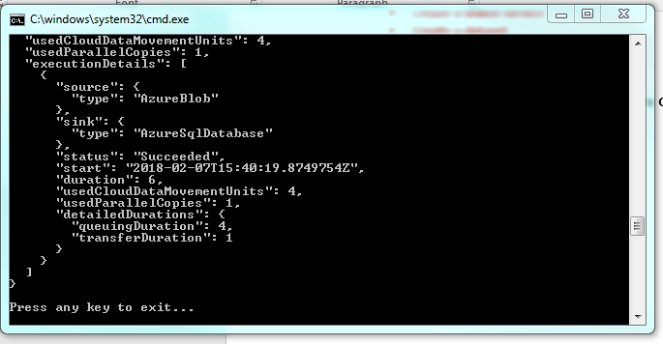
Code Overview (contd..)
The final out put when the program runs shows up in a console

Slide 15
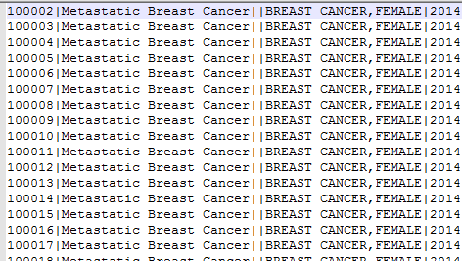
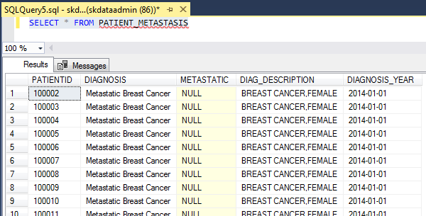
Preliminary Results
Once the program runs successfully, you will see the table contains the data from your flat file
Data in flat file
Data in table

Slide 16
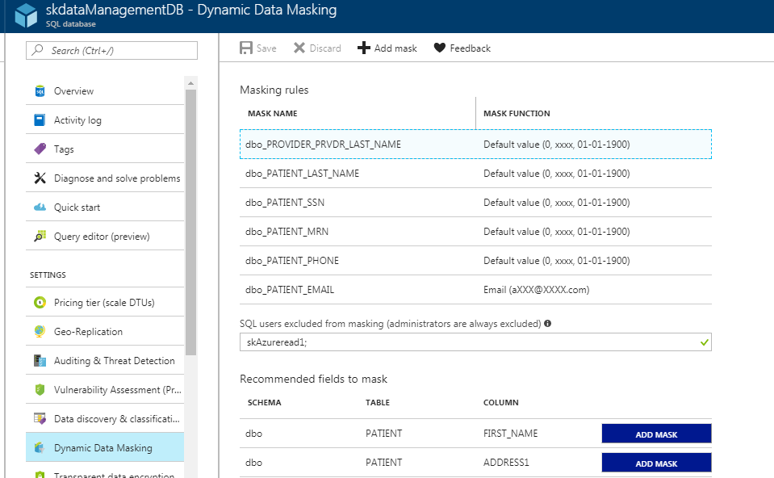
Final Results
Final results are obtained once the loaded data has been masked using Dynamic data masking
Data masking screen as seen on
azure portal

Slide 17
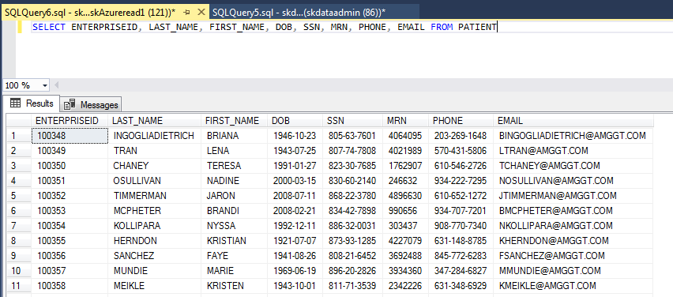
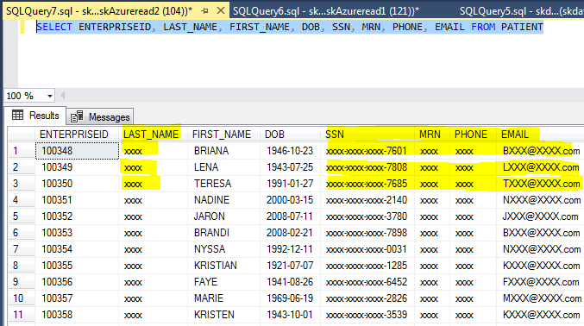
Final Results
The data view for different users
Data view for an authorized user
Data view for a restricted user

Slide 18
Data visualization
Tableau was tool of choice for visualization
Tableau provides different kind of visualization. Bar graphs and line graph was chosen for the visualization in this project
Data was anlayzed in 2 different ways
Different kind of breast cancer diagnosis by diagnosis year
Breast cancer rate by state of residence (https://www.cdc.gov/cancer/breast/statistics/state.htm)

Slide 19
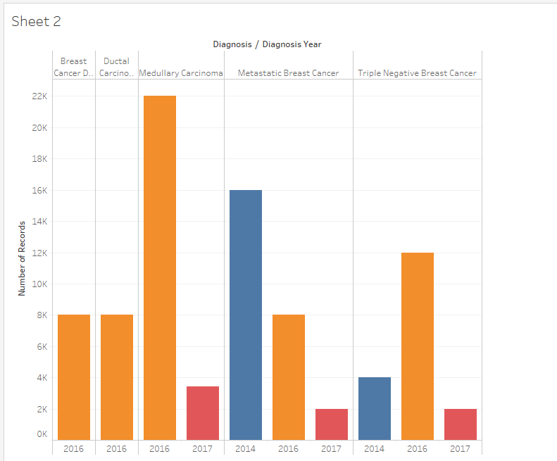
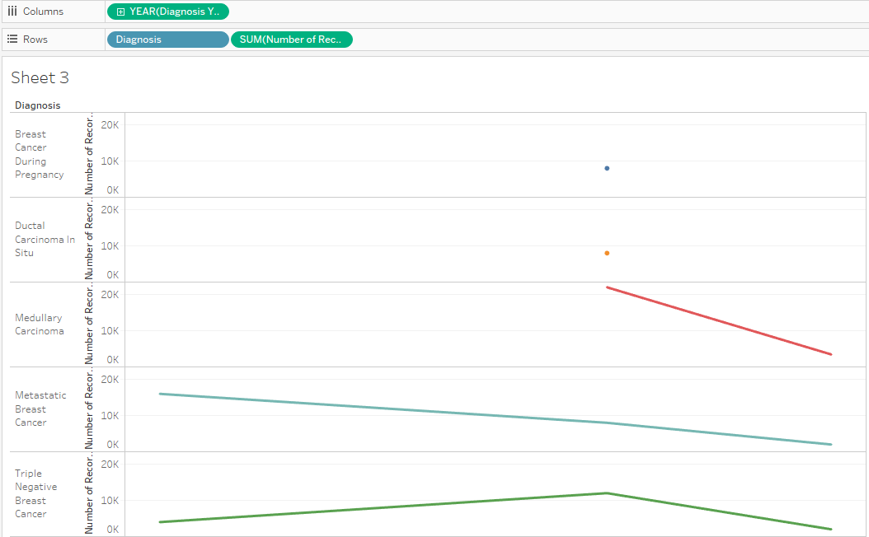
Data visualization

Slide 20
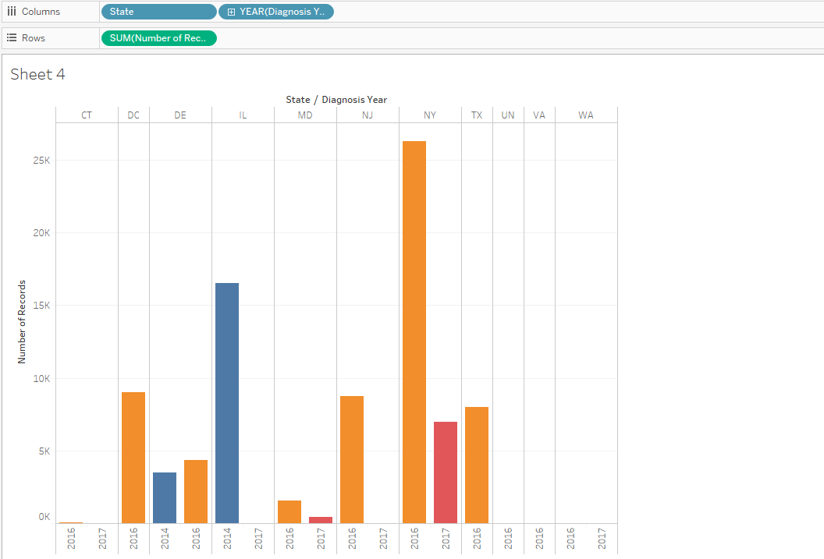
Data Visualization

Slide 21
Lessons learned
Data masking does not hurt the downstream activities on the data
Azure currently only provides dynamic data masking option which might be an issue in some cases where you actually need to mask the base data and not change the data view based on access
This masking still doesn’t support masking using custom dictionaries
Very limited customization available
There is a learning curve involved when moving large data sets to cloud and to keep up with every day loads

Slide 22
Future Work
Need to research more how to mask the data when it is present in a sql data warehouse
Options for creating a data lake and masking that data needs to be researched as well

Slide 23
URLs and Links
Github link -- https://github.com/sujathakestur/Data-Management-and-Masking
Youtube 2 minute video -- https://youtu.be/HMTSiAkJdRo
Youtube 15 minute -- https://youtu.be/ZOaRrkYNng0 (part 1)
https://youtu.be/g72kE7V34pw (part 2)

